Slide 1


The Business Case for Responding to Customer Sustainability Requests

Slide 2
Agenda
Why we are here
How the landscape has changed
Requests and why they are asking
Example - why supplier data transparency is critical
Positive impact on your business
Take Action

Slide 3
Why we are here…
GLOBAL LEGISLATION | Customers around the world are asking suppliers to be transparent with key data to comply with global legislation (ex. CBAM).
CORPORATE TARGETS AND COMMITMENTS | Customers need supply chain transparency to ensure they are meeting their stakeholder requirements and their own sustainability targets and commitments.
SUSTAINABLE PRODUCT DEVELOPMENT | Customers who continue to progress delivering sustainable products, need to partner with their supply chain to understand the impact of their material content and processing.
NEW BUSINESS AWARDS | Customers are often requiring transparency in order to earn new business.

Slide 4
How the landscape has evolved
SIMPLE
COMPLEX
Yesterday
Today
Regulation
Clients
Financial
NGOs
Judiciary
Regulation
Clients
Financial
NGOs
Judiciary
Market
Market
· "Aspirational"
· Legal
· Manageable
number of external requirements
· Massive increase
of external requirments
·
Focus on "
gate to gate"
· Whole Supply Chain
is in the focus
·
Spectrum is focused on
classic EHS topic
· Topics ranging
from human rights to sustainable finance
·
Sustainability is sparsely regulated, a topic to become
frontrunner
·
Sustainability is
regulated
, it gets harder to differentiate
Upstream
Your Company
Downstream
Upstream
Your Company
Downstream

Slide 5
Requests

Slide 6
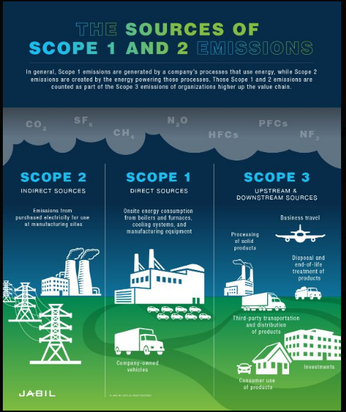
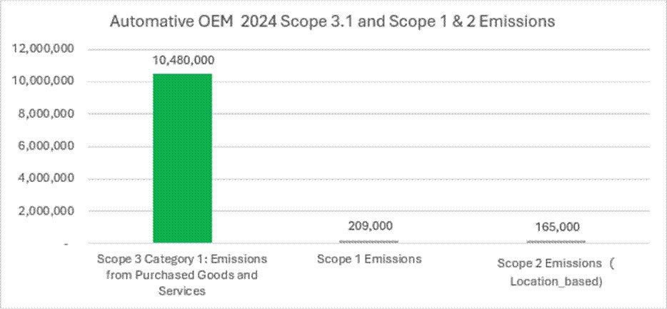
APPROACH TO EMISSIONS REDUCTION TARGETS
Example: Scope 3 Greenhouse Gas Reduction
Companies have focused on reducing emissions in their operations (Scope 1 & 2), which is within the companies’ control. Shifting focus to reduce the emissions from purchased goods and services (Scope 3) is a relatively new endeavor.
Addressing scope 3, the biggest portion of emissions, requires supplier engagement
EXAMPLE

Slide 7
Positive impact on your business
Understanding and reporting out on key metrics can provide the following:
Improved collaboration and relationships with customers
Identification of profitability improvements – lower operating costs
Improved ESG Ratings – better investor access
Brand Value & Customer Loyalty
Risk mitigation against carbon pricing
Carbon credits and tax incentives

Slide 8
Take Action
Build your infrastructure for your value chain to begin your journey on having accurate data
Understand the importance of answering and engaging with your customers
Engage with peers, councils, and advisors

Slide 9




Appendix – Additional Resources
SP
MEMA
Drive Sustainability
AIAG
Examples of automotive industry trade associations offering resources to support sustainability.

Slide 10


Appendix – Additional Resources
Task Force on Climate-Related Financial Disclosures
Online Training Materials
Taskforce on Nature-related Financial Disclosures
Online Training Materials
Examples of free educational resources to learn more about environmental-related financial disclosures and investor perspectives.

Slide 11



Questions?
Contact
info@supplierspartnership.org
www.supplierspartnership.org
Washington, DC, USA

