Slide 1
Many Trump Administration Policies Aim to Bring Jobs Back to the US: Are Companies and Workers Ready?
MEMA Policy Breakfast Series
November 8, 2017

Slide 2
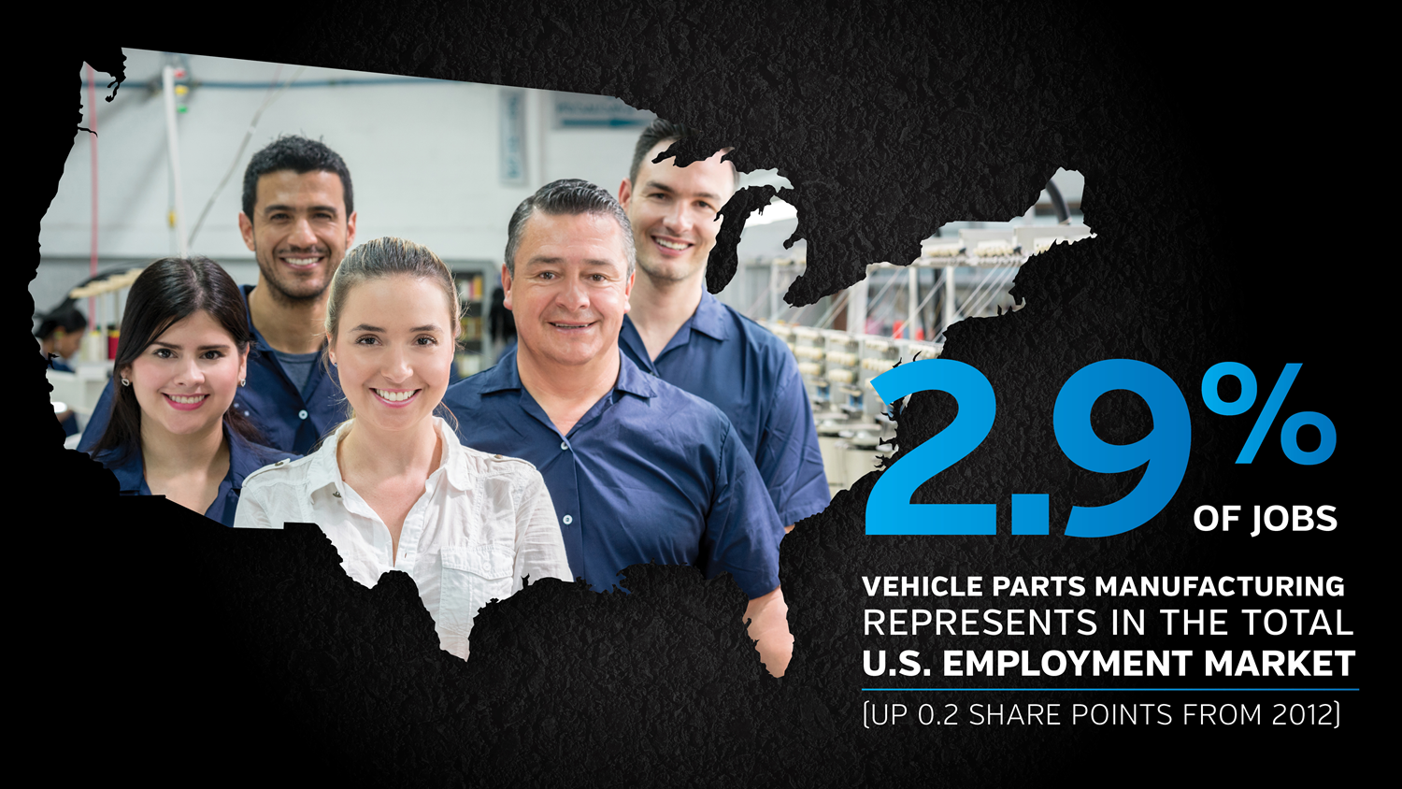
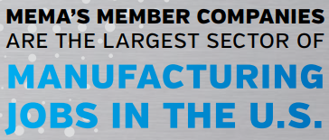
Economic Impact of Industry

Slide 3
MEMA surveyed member companies in August 2017 to determine how companies were being impacted by a shortage of “the right” talent

Slide 4
Current and Pending Skilled Labor Shortages
Skilled Labor Shortages
Percentage of Employees Eligible for Retirement

Slide 5
Impacts of Lack of Skilled Labor
Cost of Skills Gap as a Percentage Company’s Revenue in U.S.
In addition to lost revenue, 79 percent of member companies reported not pursuing business because of a lack of talent

Slide 6
Impacts of Lack of Skilled Labor
Percentage of Jobs Open Due to Lack of Skilled Labor
Skilled Trade Positions Most Desperately Needed
Tool and Die (Makers, Grinders and Repair)
Maintenance and Machine Maintenance
Machinists
Welding
Mechatronics

Slide 7
Regional Challenges and Non-Traditional Workers
Companies Report Differences in Skilled Trade Workers Based on Region
Non-traditional Workers
68 percent of respondents have taken steps to find non-traditional workers, including outreach to local rescue missions, working with migrant and ethnic groups and providing coaching in basic skills such as reading and math

